Slide 1
ATAI
Advanced Technique of Artificial Intelligence
ATAI
ChongqingUniversity _{AdvancedTechniqueof}
of Technology Artificial Intelligence
Chongqing University of
Technology
Chongqing University ^{ATAI}
_{of Technology} Advanced Techniqueof
Artificial Intelligence
Chongqing University of Technology
Chongqing University of Technology
Reducing Class-wise Confusion for Incremental Learning with Disentangled Manifolds
Code：https://github.com/lilyht/CREATE （none）
——CVPR_2025
Reported by Jingbo Liu
1

Slide 2
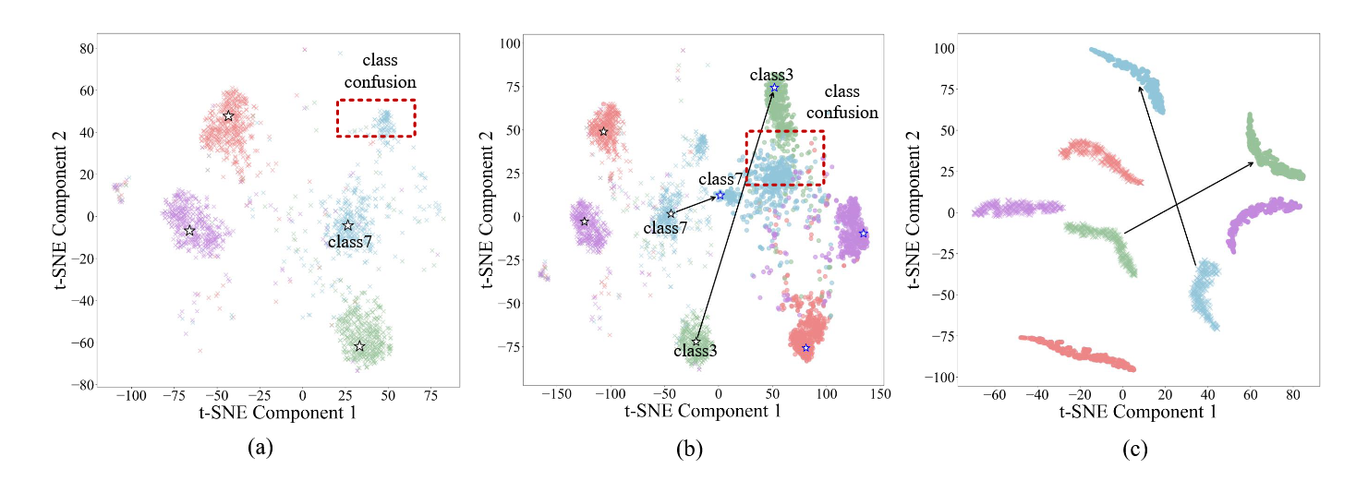
ATAI
Advanced Technique of Artificial Intelligence
ATAI
ChongqingUniversity _{AdvancedTechniqueof}
of Technology Artificial Intelligence
Chongqing University of
Technology
Chongqing University ^{ATAI}
_{of Technology} Advanced Techniqueof
Artificial Intelligence
Chongqing University of Technology
Chongqing University of Technology
Motive
(a) Class distributions and prototypes in the initial phase. Using a prototype to represent a class is incomplete.
(b) A drift in incremental learning leads to alterations in class distribution and feature overlap.

Slide 3
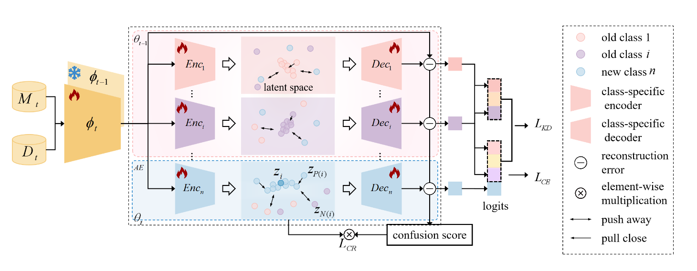
ATAI
ChongqingUniversity _{AdvancedTechniqueof}
of Technology Artificial Intelligence
Chongqing University of
Technology
ATAI
Advanced Technique of Artificial Intelligence
Chongqing University ^{ATAI}
_{of Technology} Advanced Techniqueof
Artificial Intelligence
Chongqing University of Technology
Chongqing University of Technology
Method

Slide 4
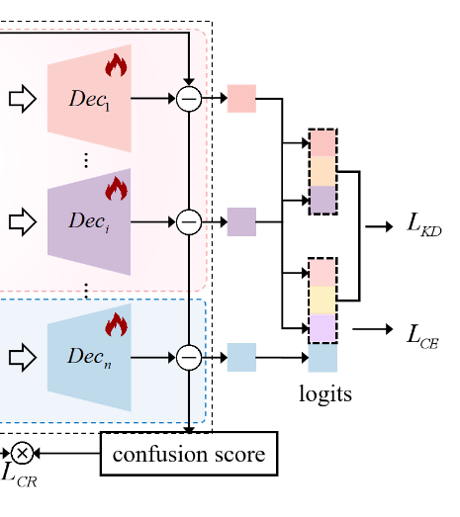
ATAI
Advanced Technique of Artificial Intelligence
ATAI
ChongqingUniversity _{AdvancedTechniqueof}
of Technology Artificial Intelligence
Chongqing University of
Technology
Chongqing University ^{ATAI}
_{of Technology} Advanced Techniqueof
Artificial Intelligence
Chongqing University of Technology
Chongqing University of Technology
Method

Slide 5
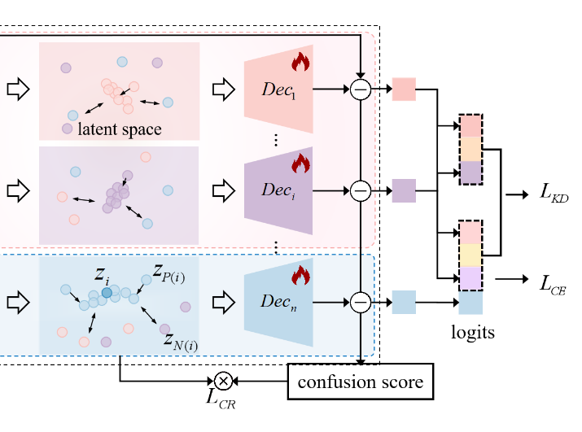
ATAI
Advanced Technique of Artificial Intelligence
ATAI
ChongqingUniversity _{AdvancedTechniqueof}
of Technology Artificial Intelligence
Chongqing University of
Technology
Chongqing University ^{ATAI}
_{of Technology} Advanced Techniqueof
Artificial Intelligence
Chongqing University of Technology
Chongqing University of Technology
Method

Slide 6
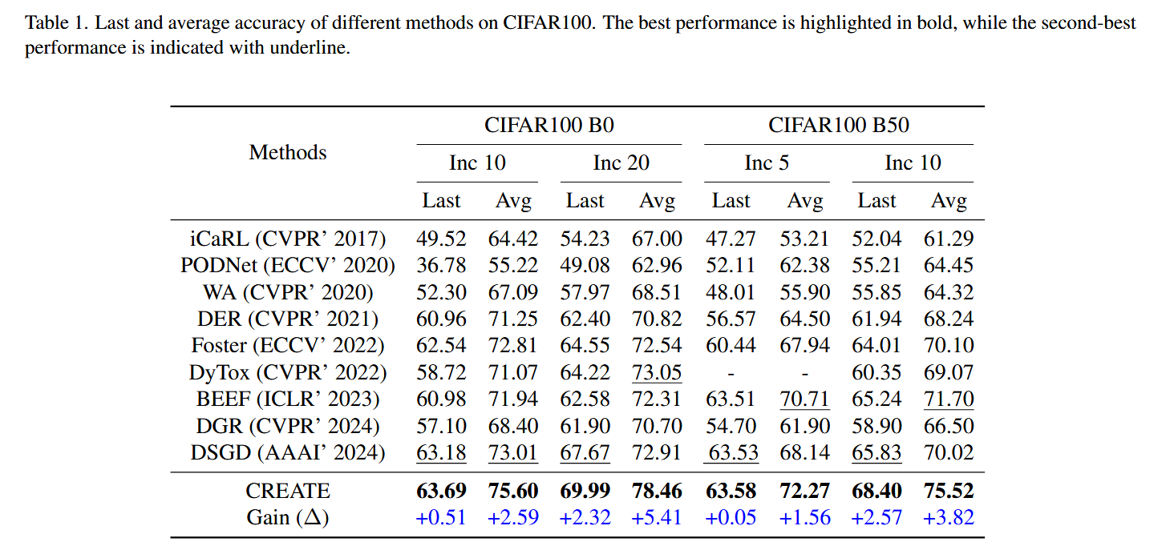
ATAI
Advanced Technique of Artificial Intelligence
ATAI
ChongqingUniversity _{AdvancedTechniqueof}
of Technology Artificial Intelligence
Chongqing University of
Technology
Chongqing University ^{ATAI}
_{of Technology} Advanced Techniqueof
Artificial Intelligence
Chongqing University of Technology
Chongqing University of Technology
Experiments

Slide 7
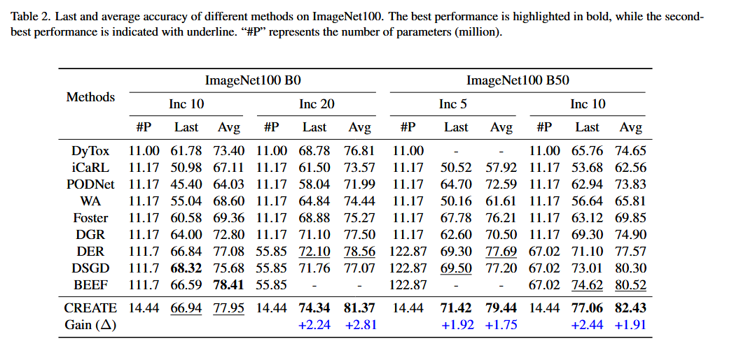
ATAI
Advanced Technique of Artificial Intelligence
ATAI
ChongqingUniversity _{AdvancedTechniqueof}
of Technology Artificial Intelligence
Chongqing University of
Technology
Chongqing University ^{ATAI}
_{of Technology} Advanced Techniqueof
Artificial Intelligence
Chongqing University of Technology
Chongqing University of Technology
Experiments

Slide 8
ATAI
Advanced Technique of Artificial Intelligence
ATAI
ChongqingUniversity _{AdvancedTechniqueof}
of Technology Artificial Intelligence
Chongqing University of
Technology
Chongqing University ^{ATAI}
_{of Technology} Advanced Techniqueof
Artificial Intelligence
Chongqing University of Technology
Chongqing University of Technology
Experiments

Slide 9
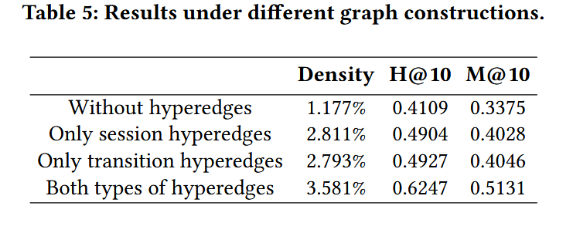
ATAI
Advanced Technique of Artificial Intelligence
ATAI
ChongqingUniversity _{AdvancedTechniqueof}
of Technology Artificial Intelligence
Chongqing University of
Technology
Chongqing University ^{ATAI}
_{of Technology} Advanced Techniqueof
Artificial Intelligence
Chongqing University of Technology
Chongqing University of Technology
Experiments

Slide 10
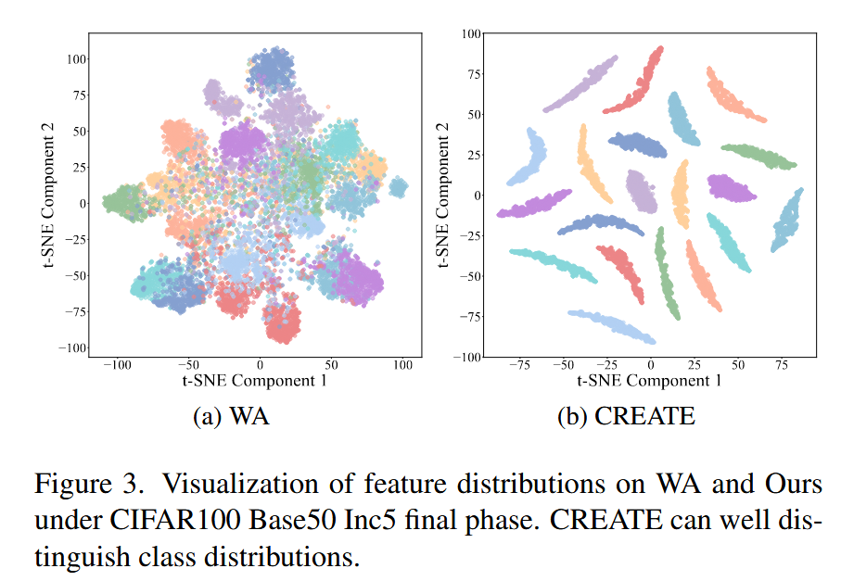
ATAI
Advanced Technique of Artificial Intelligence
ATAI
ChongqingUniversity _{AdvancedTechniqueof}
of Technology Artificial Intelligence
Chongqing University of
Technology
Chongqing University ^{ATAI}
_{of Technology} Advanced Techniqueof
Artificial Intelligence
Chongqing University of Technology
Chongqing University of Technology
Experiments

Slide 11
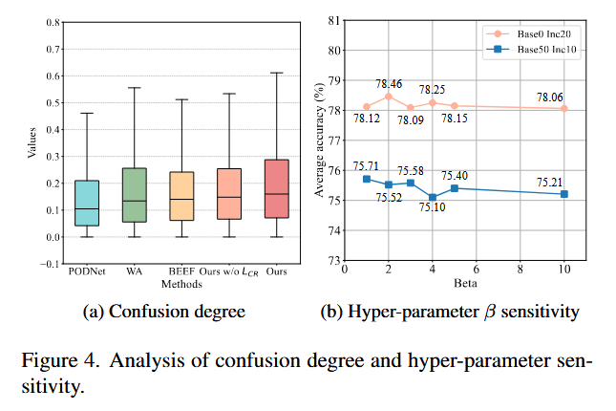
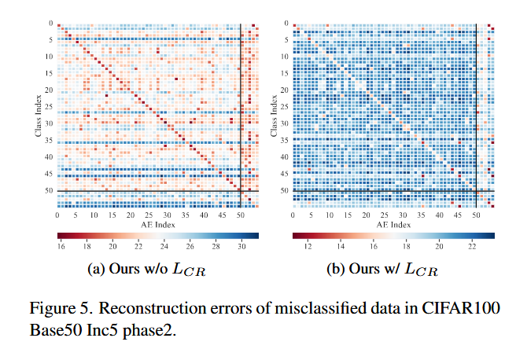
ATAI
Advanced Technique of Artificial Intelligence
ATAI
ChongqingUniversity _{AdvancedTechniqueof}
of Technology Artificial Intelligence
Chongqing University of
Technology
Chongqing University ^{ATAI}
_{of Technology} Advanced Techniqueof
Artificial Intelligence
Chongqing University of Technology
Chongqing University of Technology
Experiments

Slide 12
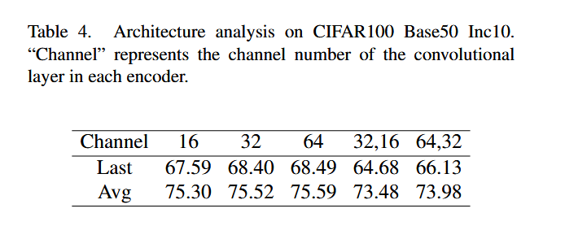
ATAI
Advanced Technique of Artificial Intelligence
ATAI
ChongqingUniversity _{AdvancedTechniqueof}
of Technology Artificial Intelligence
Chongqing University of
Technology
Chongqing University ^{ATAI}
_{of Technology} Advanced Techniqueof
Artificial Intelligence
Chongqing University of Technology
Chongqing University of Technology
Experiments

Slide 13
ATAI
Advanced Technique of Artificial Intelligence
ATAI
ChongqingUniversity _{AdvancedTechniqueof}
of Technology Artificial Intelligence
Chongqing University of
Technology
Chongqing University ^{ATAI}
_{of Technology} Advanced Techniqueof
Artificial Intelligence
Chongqing University of Technology
Chongqing University of Technology
Thanks!

